Slide 1
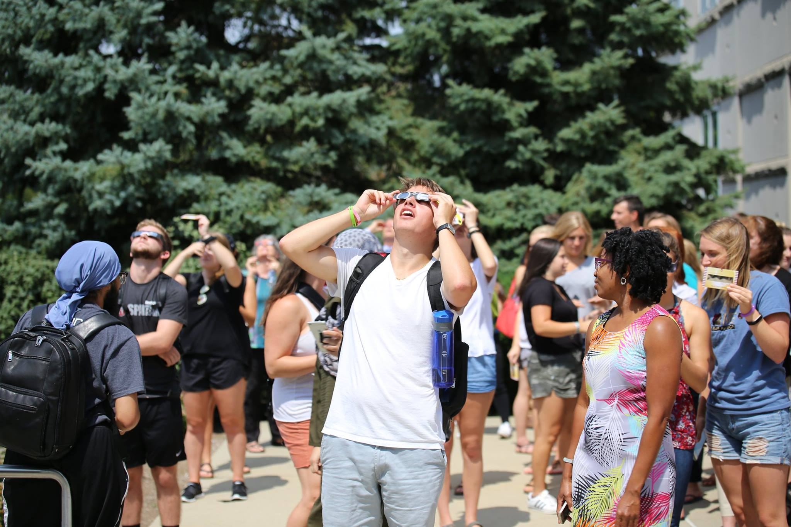
Bloomington Campus Faculty Meeting
Solar Eclipse 2017
October 27, 2017

Slide 2
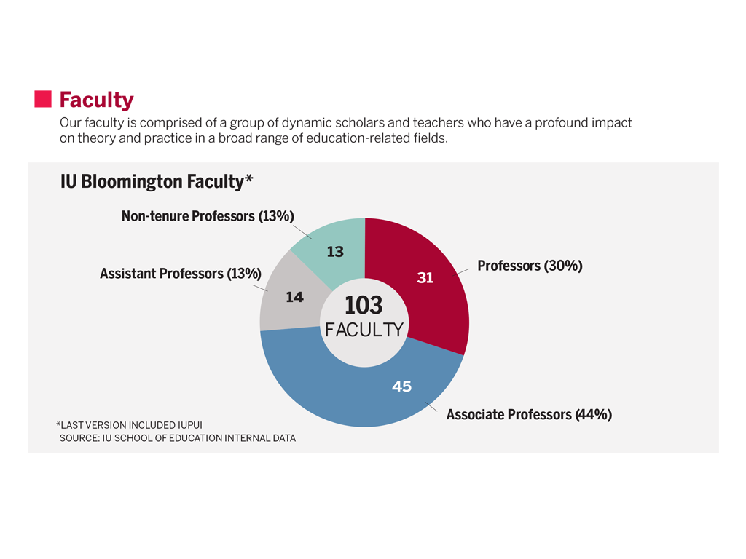

Slide 3
Faculty Demographics
Gender
Female 63
Male 40
Ethnicity
American Indian/Alaska Native 0
Asian 5
Black/African American 5
Hispanic/Latino 8
Native Hawaiian/Pacific Island 0
Two or more races 5
White 80

Slide 4
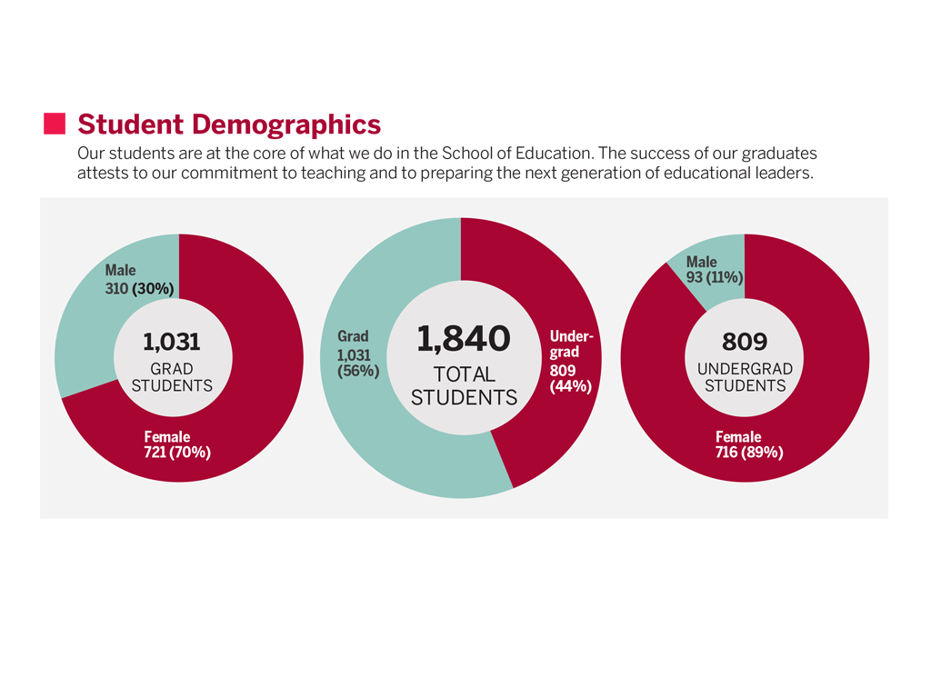

Slide 5
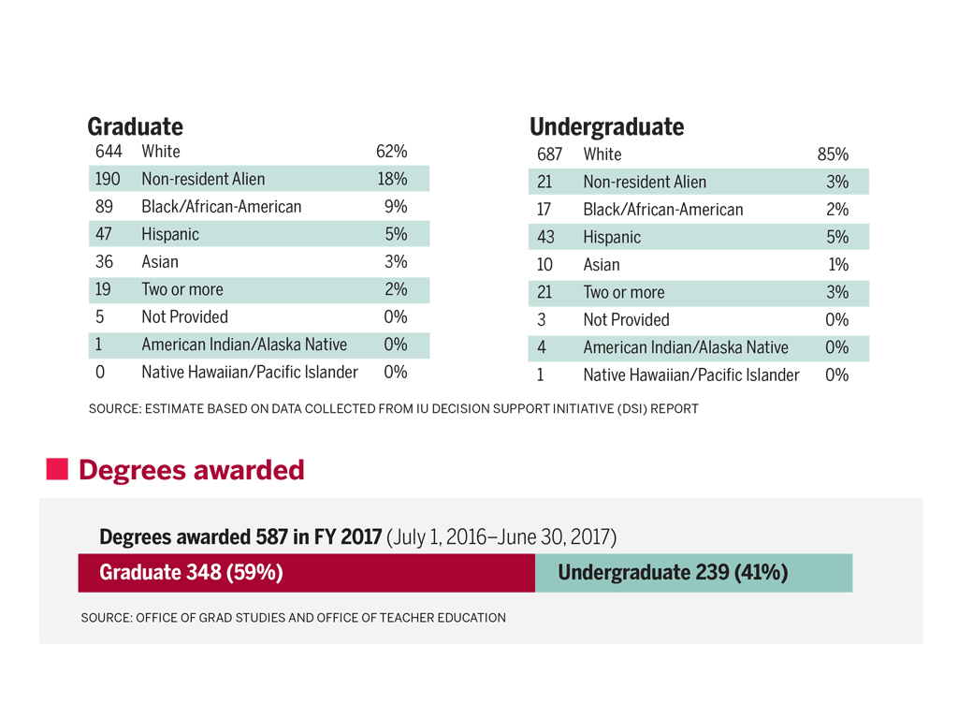

Slide 6
Teacher Education Admissions
 | 2018* | 2017* | 2016* | 1 Year Change | 2 Year Change
Applications | 729 | 674 | 550 | +8% | +33%
Admits | 195 | 191 | 163 | +2% | +20%
* Point in Time

Slide 7
TEP Admissions
378
317

Slide 8
TEP Spring Admissions
200
185
192
171
164
149

Slide 9
Sponsored Research Trends FY14 to FY18
School of Education Bloomington
 | FY 2014 | FY 2015 | FY 2016 | FY 2017 | FY 2018 July-Sept.
Proposal Numbers | 121 | 112 | 116 | 150 | 41 ↑
Proposal Dollars | $41,318,410 | $50,600,487 | $46,813,653 | $65,209,506 | $24,394,003 ↑
Award Numbers | 63 | 62 | 67 | 76 | 17 ↔
Award Dollars | $8,322,828 | $10,542,550 | $11,087,241 | $7,013,361 | $2,524,842 ↑
Indirect Dollars | $1,496,746 | $1,404,003 | $1,316,966 | $1,141,643 | $314,265 ↑
Spotlight on Current Grant Activity
Arlene Benitez $2,550,113 South Sudan Higher Education Initiative for Equity and Leadership Development Follow-on (USAID)
Cindy Hmelo-Silver $1,395,721 DAT-CROSS: Developing Assessments and Tools to Support the Teaching and Learning of Science Crosscutting Concepts (IES)
Cindy Hmelo-Silvers $1,234,535 Big Data from Small Groups (NSF)
Erik Jacobson $1,167,183 Assessing the Structure of Knowledge in Teaching Mathematics (NSF)
Kylie Peppler $1,142,667 DIP: BioSim: Developing a Wearable Toolkit for Teaching Complex Science Through Embodied Play (NSF)
Dionne Cross Francis $1,573,000 Balfour Scholars Program (Lloyd G Balfour Foundation)

Slide 10
 | Total Revenues | Total Expenses | Discretionary Transfers | Available Reserves
FY14 | 31,502,185 | 29,240,912 | 1,778,938 | 5,914,973
FY15 | 30,320,845 | 29,180,513 | 973,744 | 6,298,655
FY16 | 30,128,313 | 27,437,514 | 2,426,019 | 6,696,359
FY17 | 28,309,986 | 27,792,085 | 405,562 | 7,057,283
FY18 PROJ | 26,911,686 | 27,948,772 | (1,037,086) | 6,020,197

Slide 11

Brighten our Future

Slide 12
Dean’s Search
Meetings with Representatives from Isaacson, Miller Consultants:
Monday, November 6, 4:15-5:00pm in Room 2261 of the Wright Education Building.
Tuesday, November 7, 8:30-9:15am in Room 2261 of the Wright Education Building.

Slide 13
Poll Everywhere Instructions
Using your cell phone send a text message with the following: 22333
Then type a message with: educationdea875
Respond with a message to the prompt “As a _____, I want a dean who____”
Responses will be shared with the Dean’s Search Committee.

Slide 14
Reimagining
Education

